Slide 1
Deliverable 1
By: Dewey Decimal 7

Slide 2
Our Application
Our application will display available parking spots throughout the UMBC campus.
The app will be supported on iOS platforms as well as Android-based platforms.

Slide 3
Current Situation Without App
With the current infrastructure, there is no reliable way for people to know if a space is available in a parking lot.
That uncertainty creates a lot of the traffic congestion we all see on campus.

Slide 4
UMBC’s Business Need for the App
• This project’s goal is to provide a more reliable solution to UMBC’s parking issues.
• We will need to install smart-sensors and develop a phone application.
• As a result, people will be able to locate open parking spots available throughout the campus without driving around searching for them.

Slide 5
Business Value for UMBC
The use of technology to improve quality of life would showcase the modernity of UMBC.
This would subsequently attract more students to apply and people to bring business to UMBC seeing as how the school is innovative and capable of making technological improvements to their campus.

Slide 6
Marketing Analysis
UMBC can help advertise the application.
MyUMBC website and banners.
Market to other universities’ student government associations in order to expand.

Slide 7
Marketing Cost
Free!
Advertise on UMBC’s Page.
Refer the idea to Dr. Hrabowski.

Slide 8
Parking
UMBC has 28 total lots that faculty, commuters, and on campus residents can park in.
Sensors would be installed in all of these lots and depending on what permit you have the app will filter the lots you are eligible to park in.

Slide 9
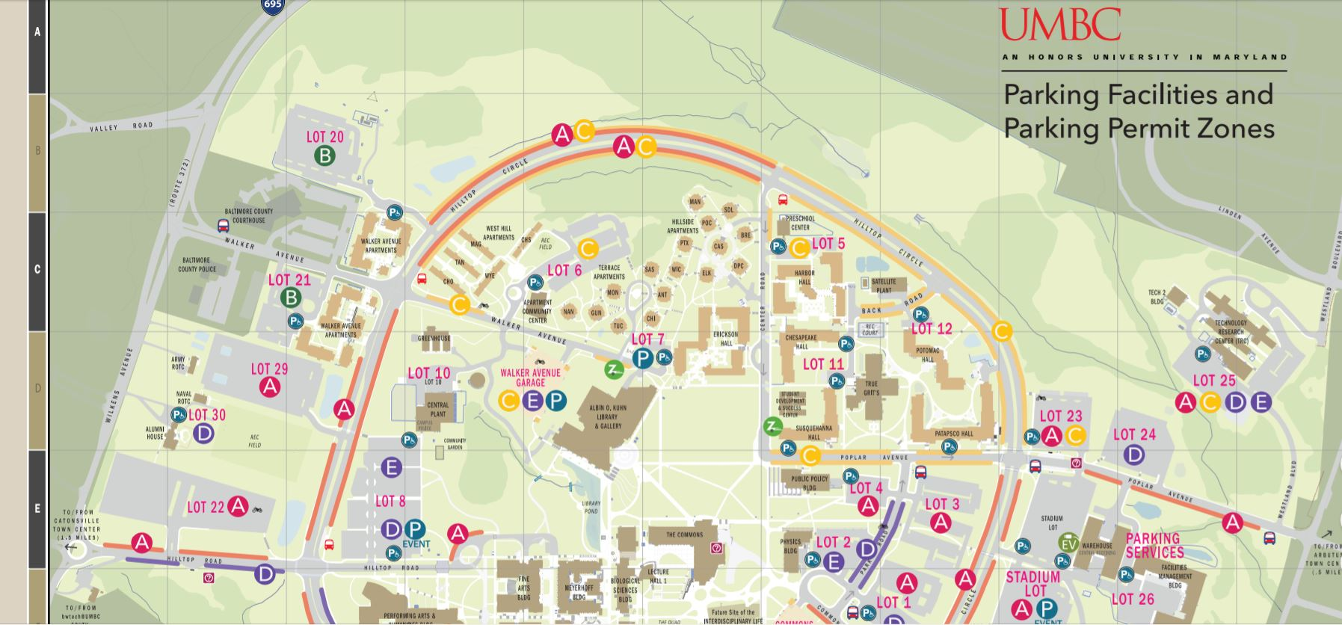

Slide 10
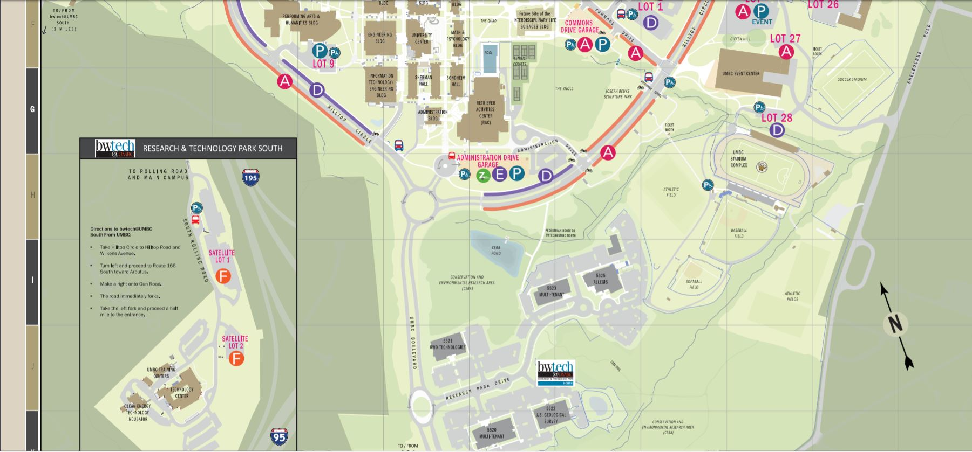

Slide 11
Technical Feasibility
Our technical requirements would include:
Experienced developers with front-and- back end experience
Ability to synchronize the app with a parking system
Knowledge of installing sensor that would be compatible with the app

Slide 12
Economic Feasibility
Our economic requirements and factors would include:
A lot of front end costs for this type of software / infrastructure
This would basically be an investment into the future of UMBC
Would attract people to coming to UMBC via advanced technology

Slide 13
Organizational Feasibility
Factors for organizational feasibility would include:
Student acceptance for the app because it solves a common issue
Brings positive attention to UMBC for continually adding to its campus
Generate revenue through more students applying to UMBC

Slide 14
What We Need to Build
For this project we will need capital for the following:
Purchasing the sensors for the parking areas.
Constructing pillars to install the laser sensors at the entrance of the Parking Lot.
Designing and Creating the Application.
Maintenance team to check the sensors.
Purchase backup sensors in case of emergency.

Slide 15
Project Constraints/Restrictions
Integrating the physical infrastructure for the system would most likely need to be done during non-peak hours/season.
The implementations time would be optimal during the summer when the campus does not have a lot of students coming to campus.
Storing the application data on UMBC cloud servers and accessing the data from the servers.

Slide 16
Project Methodology
Our group has agreed upon using the Agile Development Methodology for the following reasons:
Focus on short cycles that produce a complete software product
Highly adaptable in dynamic environments
Each release of the mobile application will be thoroughly tested to ensure quality
Can work well with UMBC’s recent trend of campus changes.
Parking lot sensors can be installed through waves and then activated for use.

Slide 17
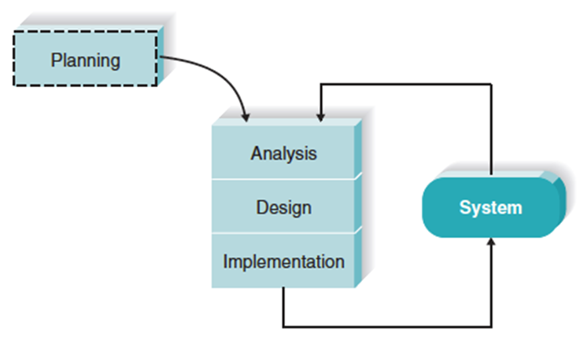

Slide 18
Project Plan
Planning (10%) 2 months
Analysis (20%) 4 months
Design (30%) 6 months
Implementation (40%) 8 months
Approx. Total Project Length 20 months

Slide 19
Project Plan Explanation
As seen in the previous slide our group believes that the most time should be devoted to the implementation stage.
This is due to the fact that our program will be made in increments where a lot of test will be conducted.
This will allow for people to give consistent feedback and our group can make changes where they are needed.

